Slide 1


MapGAN: GENERATING DIGITAL MAPS FROM SATELLITE IMAGES
PRESENTED BY:
PRAJWAL CHHETRI
SACHI KAMAT
ANUJ TIMSINA
SANDIP THAPA

Slide 2
Compared to traditional maps, electronic models have a better advantage since they have higher accuracy and absence of distortions as well as automatic routing and control over deviations from the selected course.
WHY DO WE NEED DIGITAL MAPS?

Slide 3
To generate a standard layer of maps from satellite images using conditional-GAN.
CONCEPT

Slide 4

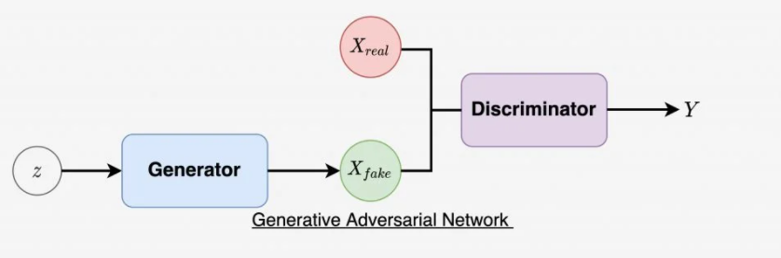
GAN
GAN is an analogous type of idea generated to model animal behavior by researchers around 2013 (Bryant, 2013). It is a relative innovation in the field of deep learning that uses two different networks on that generates images.

Slide 5
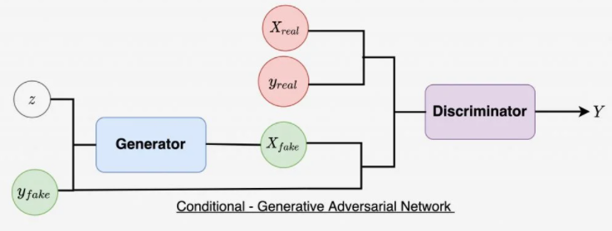
cGAN
In cGAN, a conditional setting is applied, meaning that both the generator and discriminator are conditioned on some sort of auxiliary information from other modalities. As a result, the ideal model can learn multi-modal mapping from inputs to outputs by being fed with different contextual information.

Slide 6
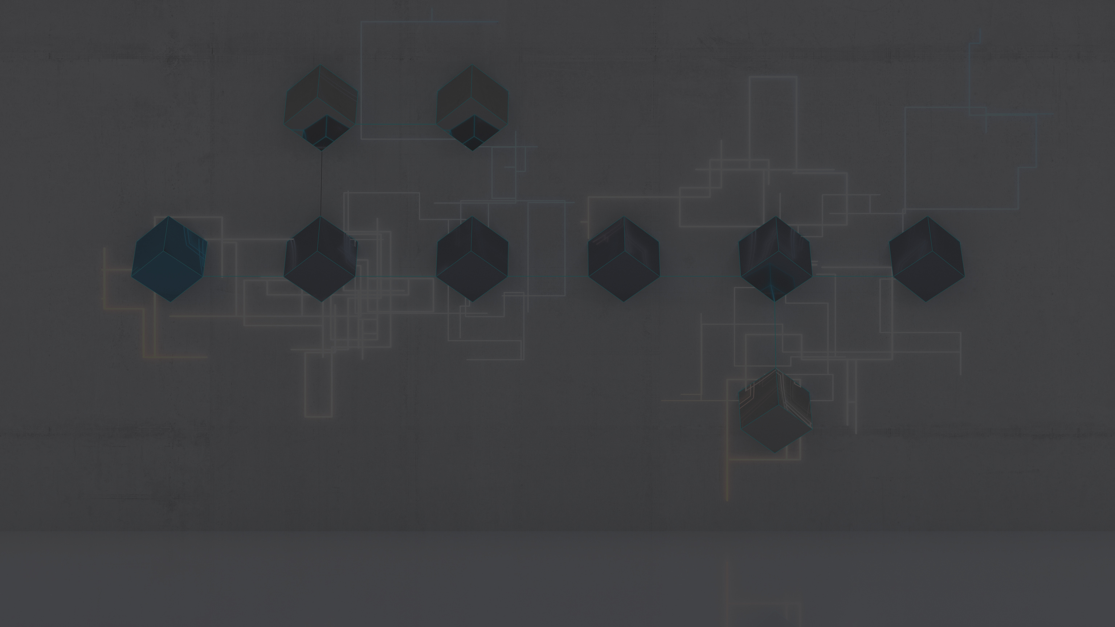

GAN REAL WORLD APPLICATIONS
Generate Realistic Photographs
Generate Cartoon Characters
Image-to-Image Translation
Text-to-Image Translation
Semantic-Image-to-Photo Translation
Generate New Human Poses
Face Aging
Super Resolution
Video Prediction
3D Object Generation

Slide 7
Besides the others features provided by GAN our project mostly focuses on :
Ability to model high-dimensional data
Capacity to provide multi modal outputs or multiple plausible answers.
High success rate
Better Computational speed and power
WHY GAN ?

Slide 8
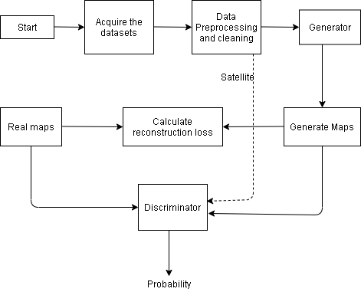
BLOCK DIAGRAM
Satellite
Probability

Slide 9
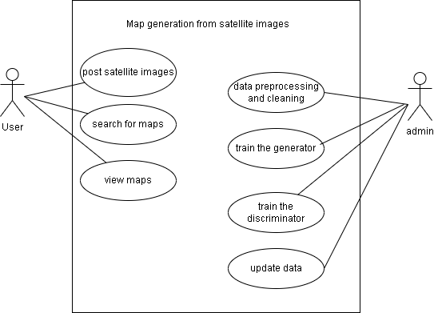
Use Case Diagram
Satellite

Slide 10
LOSS FUNCTION
Discriminator Loss: max_{(D)} E_{x~P(x)} [log(D(x))]+ E_{z~Pz(z)} [log(1-D(G(z)))]
Generator Loss: min_{(G)} E_{x~P(x)} [log(D(x))]+ E_{z~Pz(z)} log(1-D(G(z)))]
Reconstruction Loss: ||M_{fake}-M_{real}||₂

Slide 11

METHODOLOGY

Slide 12
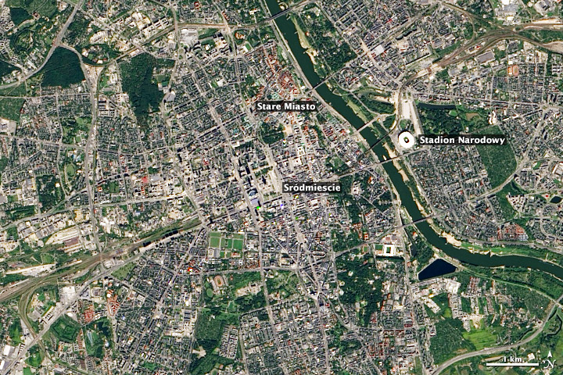
Takes a satellite image as an input

Slide 13
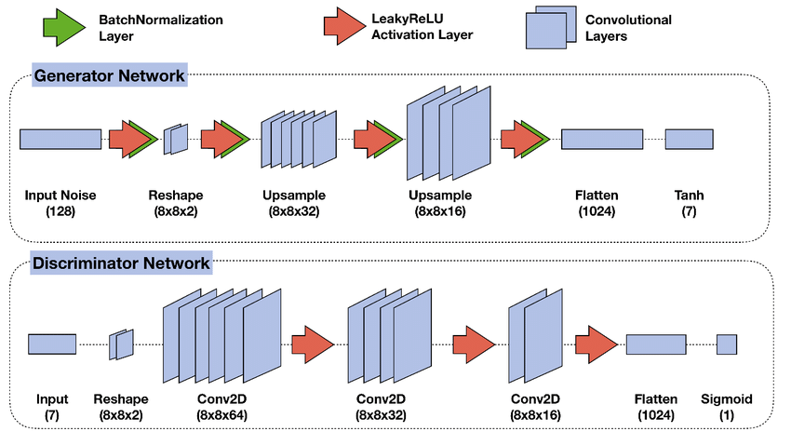
Generator and Discriminator are two models in the network.

Slide 14
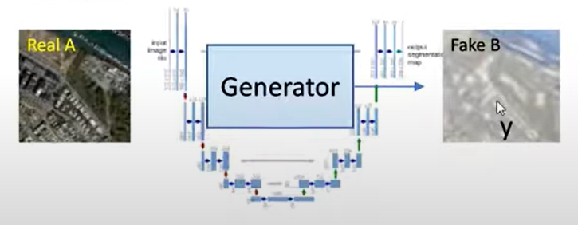
Generator generates fake target image using real image input.

Slide 15
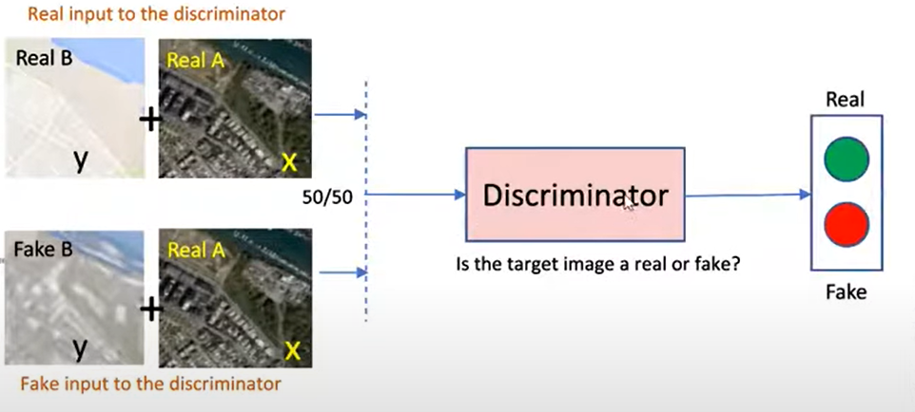
Discriminator is fed with pairs of input image and target image as inputs and outputs whether the image is real or fake.

Slide 16
Optimization is carried out to generator and discriminator loss.

Slide 17


